Slide 1
Kaggle Competition
Predict Future Sales
Prepared for 1C Company
October 16, 2018
Pune | +91 20 6606 5000

Slide 2
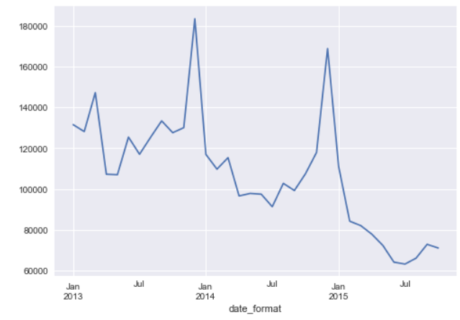
Exploratory Data Analysis + Preliminary Insights
Distribution of number of items sold across months
Number of sold items declines over the years
Peak in November and December
Continuous yearly seasonal movement across the months
Since yearly seasonal- incorporate lag features- up to 12 months prior. To account for the changes across months- lag of 1,2,3,5, 12 found
The list of shops and products slightly changes every month-
Therefore, generating all possible shop-item pairs for each month in train set and assigning missing item count with 0 makes
5 Holiday Boolean Flags created to mark major holiday months-
December, New Years (for January), Valentines (February), Women's Day (March), Easter (April)

Slide 3
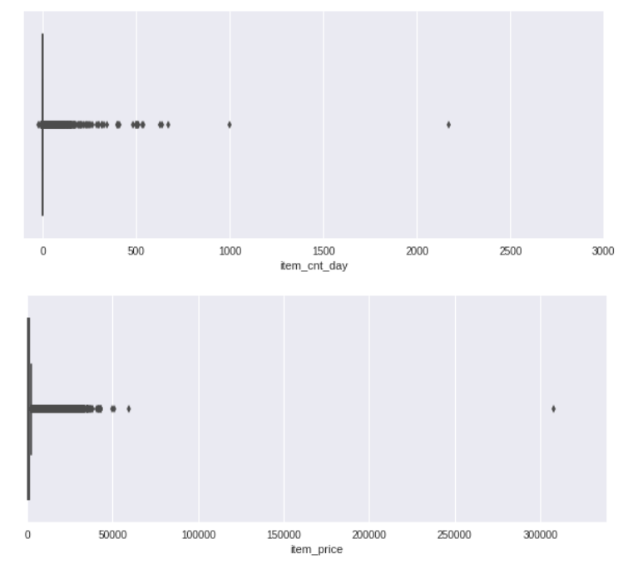
Exploratory Data Analysis + Preliminary Insights
Sales per day-
Heavily skewed-most of the values are zero.
0,20 range contain 99.9% of the data range. Therefore, clipping the target to (0,20)
Removing items with sales > 1,001
Remove items with price > 100,000

Slide 4
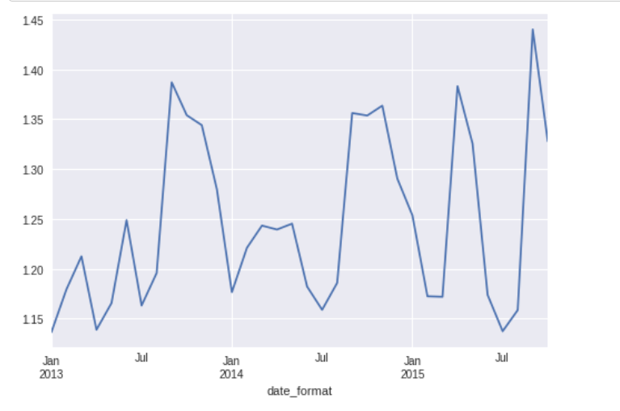
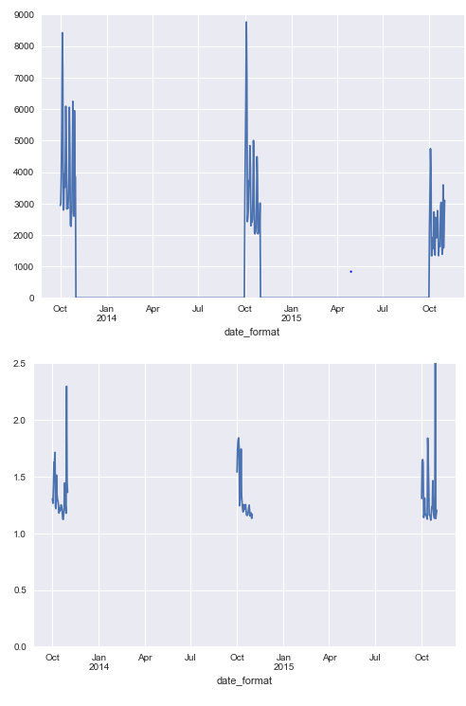
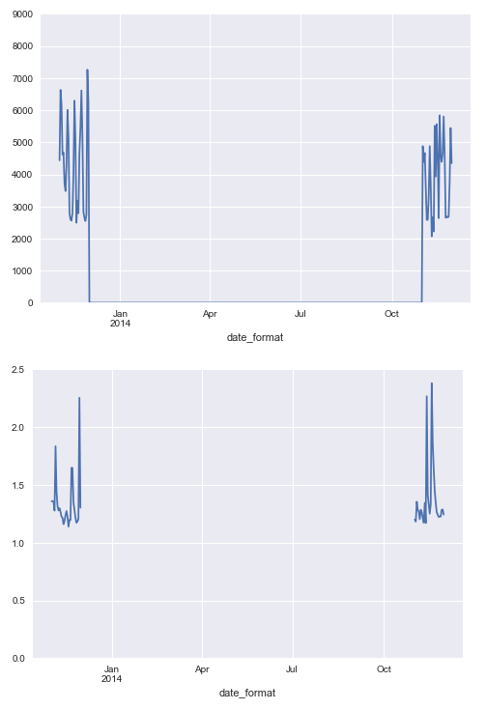
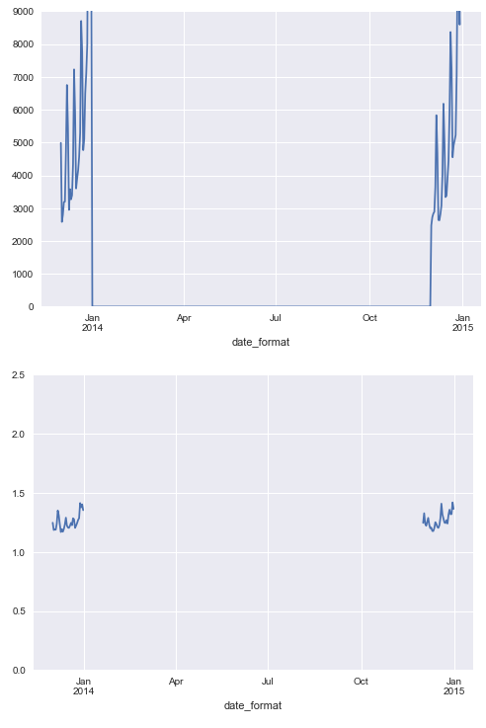
Exploratory Data Analysis + Preliminary Insights
Distribution of mean of items sold across months
Mean counts per month show a different pattern than total sales
In features, incorporate the mean values as well
Total sales for each day of October, November, December
Mean sales for each day of October, November, December

Slide 5
Feature Engineering
Aggregated Features
Lag Features-
Additional Features-
Sum of Item counts for -
Each shop per month
Each item per month
Each item category per month
Mean of Item counts for -
Each shop per month
Each item per month
Each item category per month
Total of items sold for each shop, item pair in each month
Calculating the features created in the previous step at prior time steps
Time steps are: 1,2,3,5 and 12 months
All sale record before 2014 are dropped, since there would be no lag features before 2014 as we have a 12-month lag
5 Holiday Boolean Flags created to mark major holiday months-
December
New Years (for January)
Valentines(February)
Women's Day (March)
Easter (April)

Slide 6
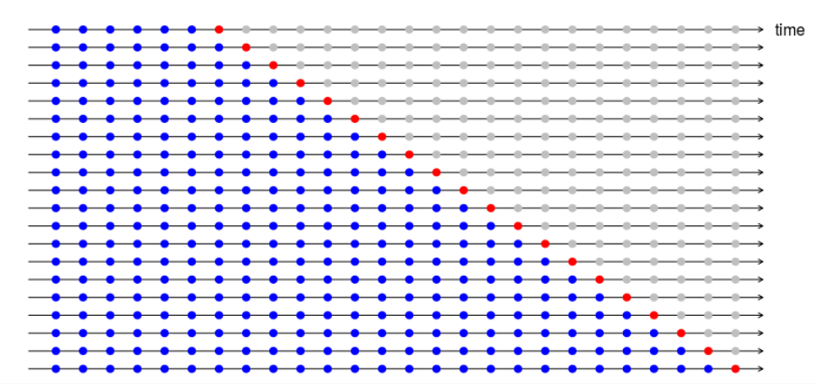
Modelling-Light GBM with 6 Fold Cross Validation
Red dots represent the validation set and the blue dots represent the training set
We have considered months 28 to 33 as part of our validation set for 6 Fold Cross Validation
Mean Cross Validation RMSE is then calculated
Least Mean Cross Validation RMSE: 0.807
Least Training RMSE: 0.607
Least Test RMSE (From Kaggle): 1.143
Possible Case of overfitting occurring-
Tried resolving using the parameters in lightGBM (max depth, max. number of leaves, bagging, % features sampled, % data sampled, min data in leaves, learning rate, L1 and L2 regularization)

Slide 7
Modelling-Ride Regression
Using train-validation, obtained the best value of alpha for L2 regularization and trained using the obtained values
Kept the 33rd month as validation set and < 33 as training set for finding the best alpha value
Least Validation RMSE: 0.964
Least Training RMSE : 0.989
Least Test RMSE (From Kaggle): 1.104

Slide 8
Validation
Used Hyperopt for Parameter Optimization:
Distributed Asynchronous Hyper-parameter Optimization
Search algorithms for Sequential model-based optimization (Bayesian optimization) to find the best set of hyperparameters within a search space
Tree of Parzen Estimators is the algorithm used
Space over which parameters were optimized:
max depth
max. number of leaves
bagging
% features sampled
% data sampled
min data in leaf
learning rate
L1 and L2 regularization

Slide 9
Further exploration possible:
On top of Hyperopt, use GridsearchCV for refining parameter optimization
Additional features including-
Price
Revenue
Difference amongst features across months
Months since last sale
Number of days in the month
Exploring other models-
Time Series: AR, MA, ARMA, ARIMA
Ensemble Models
Neural Networks

Slide 10
Resources
LightGBM:
https://lightgbm.readthedocs.io/en/latest/Parameters-Tuning.html
https://www.kaggle.com/pranav84/lightgbm-fixing-unbalanced-data-lb-0-9680
https://lightgbm.readthedocs.io/en/latest/Parameters.html
https://www.kaggle.com/garethjns/microsoft-lightgbm-with-parameter-tuning-0-823
https://media.readthedocs.org/pdf/lightgbm/latest/lightgbm.pdf
https://towardsdatascience.com/catboost-vs-light-gbm-vs-xgboost-5f93620723db
https://sadanand-singh.github.io/posts/boostedtrees/
https://www.avanwyk.com/an-overview-of-lightgbm/
https://www.kaggle.com/ogrellier/lgbm-regularized-random-forest
Hyperopt:
https://github.com/hyperopt/hyperopt/wiki/FMin
https://www.kaggle.com/c/utexasdatasciencelab/discussion/24795
http://fastml.com/optimizing-hyperparams-with-hyperopt/
https://medium.com/district-data-labs/parameter-tuning-with-hyperopt-faa86acdfdce
Cross Validation in Time Series:
https://towardsdatascience.com/time-series-nested-cross-validation-76adba623eb9- CV
https://robjhyndman.com/hyndsight/tscv/
Parameter Tuning in Gradient Boosting:
https://www.analyticsvidhya.com/blog/2016/02/complete-guide-parameter-tuning-gradient-boosting-gbm-python/
Ridge Regression:
https://www.analyticsvidhya.com/blog/2016/01/complete-tutorial-ridge-lasso-regression-python/
http://scikit-learn.org/stable/modules/generated/sklearn.linear_model.LinearRegression.html

